Slide 1
ASP.NET MVC5 + GrapeCity Active Reports 13 DEMO
Made by: Slava Fesenko, Sophie Babenko

Slide 2

What is active Reports
Winforms
PDF
C#
Excel
ASP.NET
RTF
HTML 5
Word
Notes:
ActiveReports is a .NET reporting tool used by developers of WinForms, ASP.NET, and HTML5 applications. It was originally developed by Data Dynamics, which was then acquired by GrapeCity. ActiveReports is a set of components and tools that facilitates the production of reports to display data in documents and web-based formats. It is written in managed C# code and allows Visual Studio programmers to leverage their knowledge of C# or Visual Basic.NET when programming with ActiveReports.
Among the components included with ActiveReports are exports to file formats such as PDF, Excel, RTF, and Word. The main components are a Visual Studio integrated report designer, and an API that developers use to create customized reports from a variety of data sources. ActiveReports Standard Edition also includes a Visual Query Designer, a customizable Windows Viewer control, an HTML5 Viewer control, and a WPF Viewer control.

Slide 3
Types of active Reports
Section Report
Page Report
RDL Report
Notes:
The integrated report designer handles three types of reports:
Section Reports with banded sections like the original ActiveReports (reminiscent of Microsoft Access reports)
Page Reports with a fixed layout for forms
RDL Reports with a continuous page layout like the original Data Dynamics Reports (uses Report Definition Language)

Slide 4




Plan of a demo application
Database
Users
User Info
Reports

Slide 5
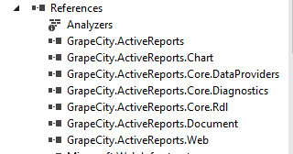
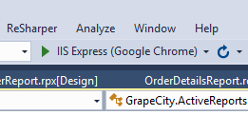
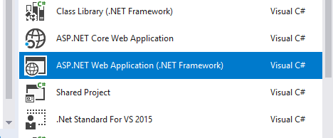
Which instruments we used
+
=
DEMO APP
ASP.NET MVC 5
GrapeCity
libs

Slide 6

Live demo

Slide 7

Any questions?

Slide 8

Thank you for attention!

